Slide 5
[Add your unit’s mission statement here or mandate here]

Slide 11
[Insert goal here]

Slide 15
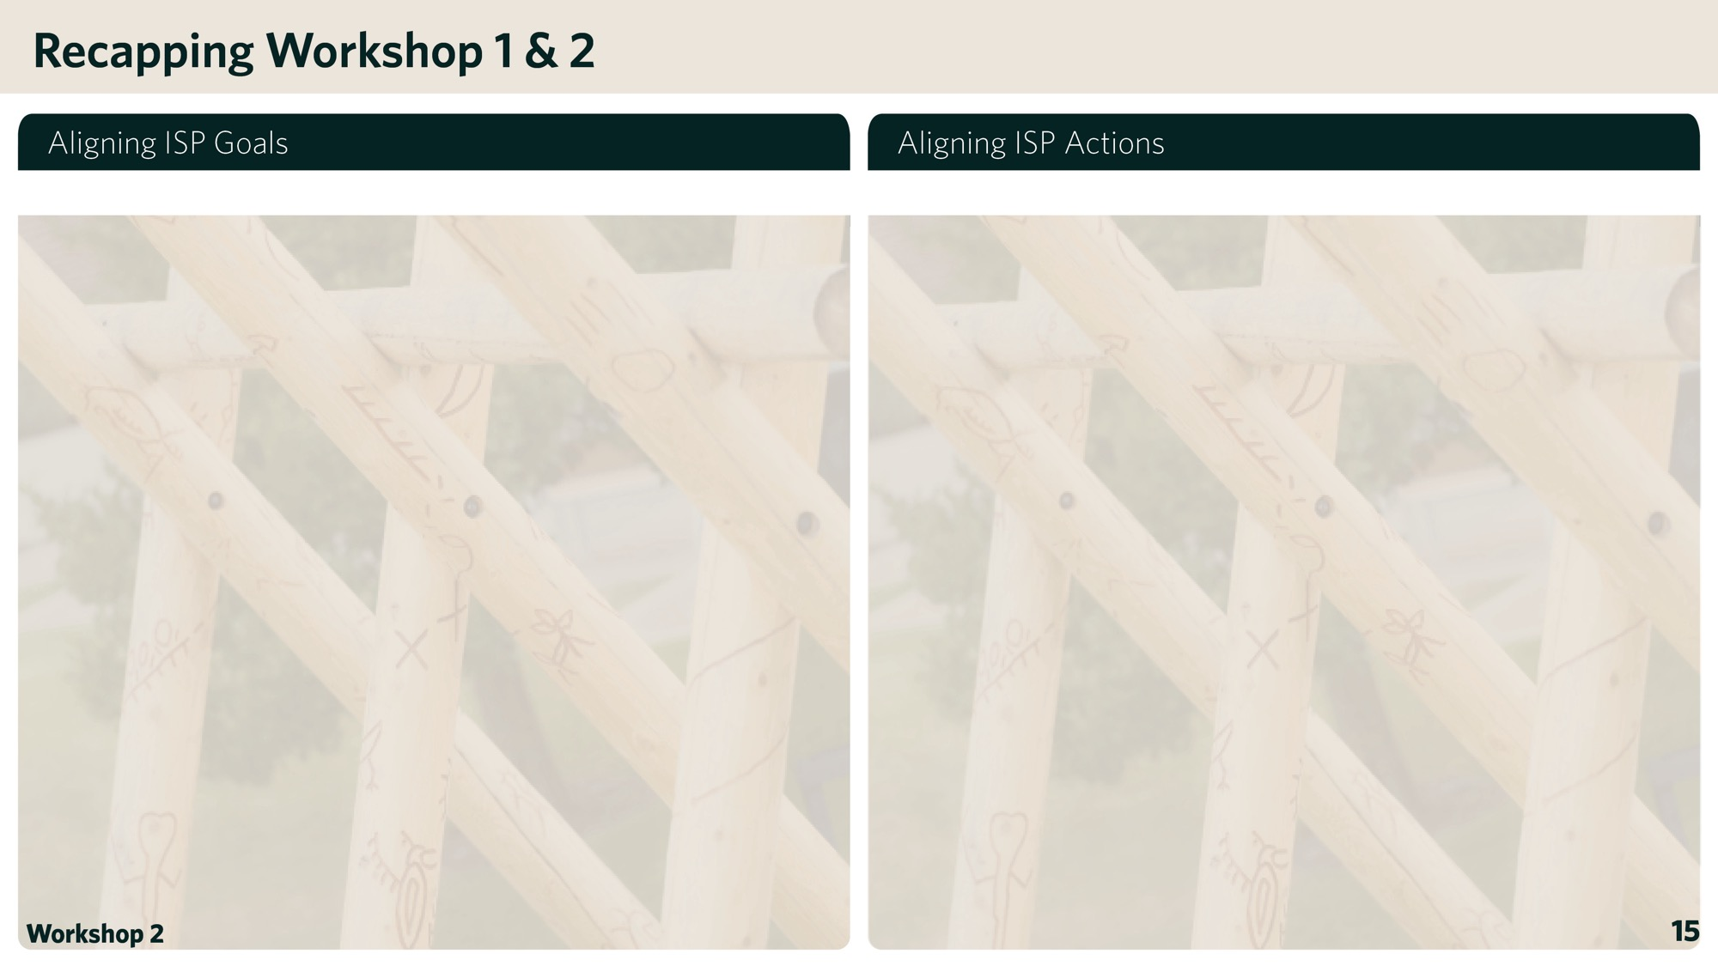
[Insert ISP Goal] + [Insert ISP Action]
[Insert ISP Goal] + [Insert ISP Action]

Slide 16
[Insert ISP Goal] + [Insert ISP Action]

Slide 17
[Insert ISP Goal] + [Insert ISP Action]

Slide 18
[Insert ISP Goal] + [Insert ISP Action]

Slide 19
[Insert ISP Goal] + [Insert ISP Action]

